Slide 1


X
Optimization of Conversion UX Research
Telkom Digital Amoeba - UX Researcher
Presented by
Grace Yosephine

Slide 2





Insert your photo here
Grace Yosephine
About Me
Im a student at Institut Teknologi Del, majoring in Software Engineering Technology. I have a strong interest in UX (User Experience) research and am passionate about understanding user behavior to create better, more intuitive digital products. Throughout my studies, I have gained knowledge in software development, including programming languages such as Java, Python, and JavaScript, as well as database management and object-oriented programming.
Im particularly drawn to UX research because it combines technology, psychology, and design thinking—allowing me to explore how users interact with digital systems and how those experiences can be improved.
Medan, Sumatera Utara
graceyosephine63@gmail.com
https://www.linkedin.com/in/grace-yosephine-479233294/

Slide 3

About Company
Telkom Digital Amoeba is an internal innovation lab established by Telkom Indonesia to foster a culture of intrapreneurship among its employees. Launched in 2017, the program empowers Telkom staff to develop and incubate their own digital startup ideas within the company, providing mentorship, resources, and a structured framework to bring these innovations to life.
One of Digital Amoeba's flagship initiatives is IdeaBox, a comprehensive crowdsourcing platform designed to streamline the innovation process. IdeaBox facilitates idea submission, team formation, real-time insights, and event management, creating an ecosystem where creative solutions can be nurtured and connected with potential investors.
Through these initiatives, Telkom Digital Amoeba has successfully launched several digital products, such as Emago, a game streaming service, and Arkademy, an online learning platform for vocational students. By leveraging internal talent and fostering a startup mindset, Telkom Digital Amoeba plays a pivotal role in driving the company's digital transformation and contributing to Indonesia's broader digital ecosystem.

Slide 4
Project Portfolio
Background
The IdeaBox platform enables users to submit innovative ideas for investor funding. Data analysis reveals a significant drop-off after the notification stage, preventing many users from publishing their ideas on the investor dashboard. This project aims to identify barriers and propose solutions to improve conversion rates.
Problem Statement
Many IdeaBox users abandon their journey after receiving notifications, resulting in low conversion to the final stage of publishing ideas on the investor dashboard. The goal is to increase the number of users completing the submission process by addressing pain points through data analysis, surveys, and usability testing.

Slide 5
Project Portfolio
Available Data
User Activity (Jan–Mar 2022): Total, new, and returning users.
Funnel Data: User progression through eight stages of idea submission.
Demographics (Mar 2022): Age, gender, geography, interests, and session duration from Google Analytics.

Slide 6
Data Analysis
Strategy
To strengthen the background and identify bottlenecks, I analyzed the provided Excel dataset focusing on:
Month-to-Month User Growth: To assess platform adoption trends.
User Type Analysis: To understand the proportion of new vs. returning users.
Funnel Analysis: To pinpoint the stage with the largest drop-off.

Slide 7
Data Analysis
Results and Explanation
a. Month-to-Month User Growth
Total users: January (143,274), February (154,321), March (167,864).
Growth rates:
1) Jan to Feb: (154,321 - 143,274) / 143,274 × 100 = 7.71%
2) Feb to Mar: (167,864 - 154,321) / 154,321 × 100 = 8.77%
Explanation
The 7–8% monthly growth indicates strong user acquisition, but conversion within the submission funnel needs improvement to capitalize on this trend.

Slide 8
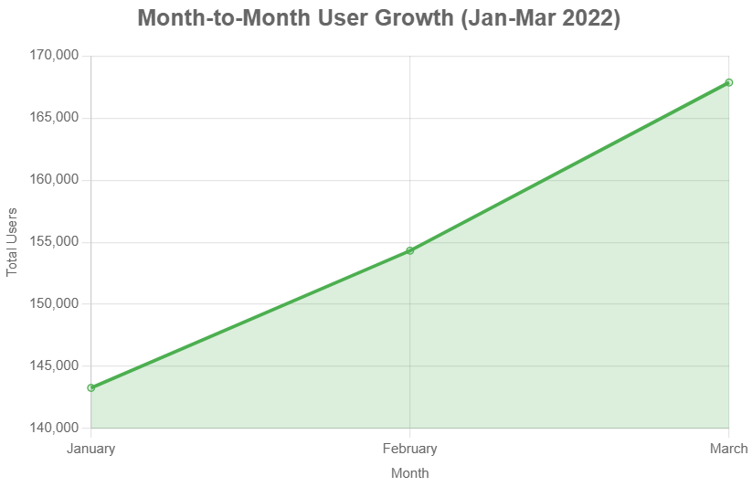
Data Analysis

Slide 9
Data Analysis
Results and Explanation
b. User Type Analysis
March 2022:
1) New Users: 124,528 (74.2%)
2) Returning Users: 43,336 (25.8%)
Explanation
The high proportion of new users (74.2%) reflects effective acquisition but highlights the need for retention strategies to increase returning users, who may be more likely to complete submissions..

Slide 10
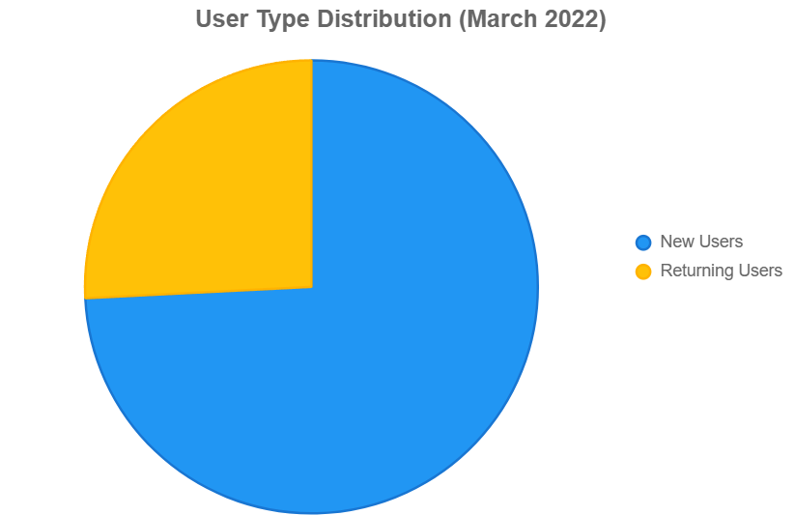
Data Analysis

Slide 11
Data Analysis
Results and Explanation
c. Funnel Analysis
March 2022 funnel:
1) Part 1 (Choose Submit Idea): 167,864
2) Part 2 (Input Data): 156,342 (6.8% drop)
3) Part 3 (Input Prototype): 154,442 (1.2% drop)
4) Part 4 (Receive Notification): 123,423 (20.1% drop)
5) Part 5 (Open Email Confirmation): 54,231 (56.0% drop)
6) Part 6 (Terms and Conditions): 54,221 (0.02% drop)
7) Part 7 (Preview Idea): 54,110 (0.2% drop)
8) Part 8 (Publish Idea): 53,210 (1.7% drop, 68.3% drop from Part 1)
Explanation
The largest drop-off (56%) occurs between Part 4 and Part 5, suggesting users are confused about checking their email or find the notification unclear.

Slide 12
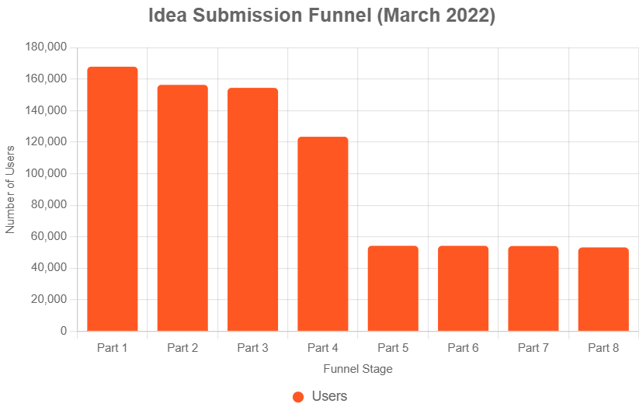
Data Analysis

Slide 13
Data Analysis
Demographic Insights
Age (Mar 2022): 18–24 (40%), 25–34 (36%), 35–44 (13%), 45–54 (8%), >54 (3%)
Gender: Male (53%), Female (47%)
Geography: Jakarta (24%), Surabaya (18%), Bandung (15%)
Session Duration: 61–180s (34%), 181–600s (26%)
Explanation
Young adults (18–34, 76%) dominate, with balanced gender distribution. Moderate session durations suggest engagement but potential interface complexity.

Slide 14
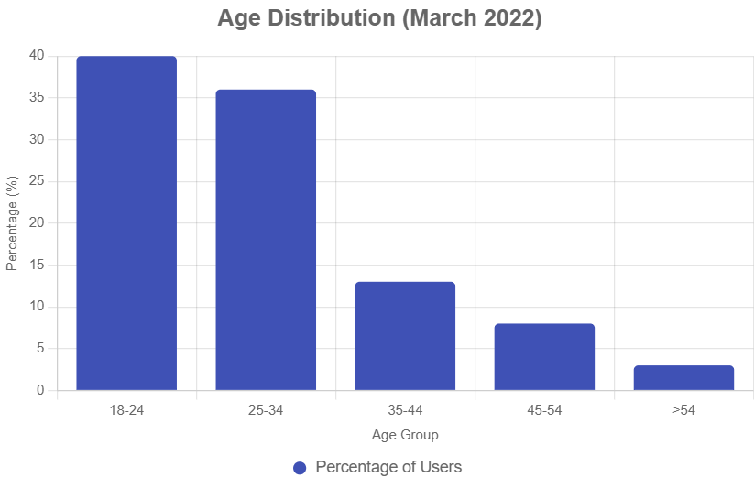
Data Analysis

Slide 15
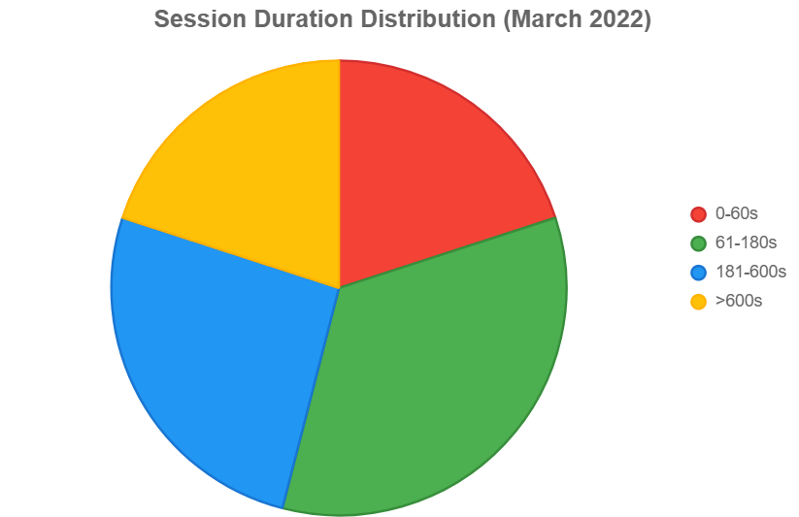
Data Analysis
Session Duration Distribution
This diagram shows session duration to assess engagement. The high percentage of short sessions (61–180s, 34%) suggests users may find the process complex, contributing to drop-off.

Slide 16
Research Plan
Strategy
To address the 56% drop-off between Part 4 and Part 5, I designed a research plan using surveys and usability testing (UT) to identify barriers and improve conversion to the investor dashboard.
Result and Explanation
a. Background
The 56% drop-off between receiving notifications and opening email confirmations indicates users are confused about next steps or unaware of the need to check their email.
b. Business Objective
Increase the percentage of users completing the idea submission journey to publish on the investor dashboard by 20% within six months.

Slide 17
Research Plan
c. Support Metrics
Conversion rate from Part 4 to Part 8 (current: 43.1%, target: 51.7%).
Single Ease Question (SEQ) score post-UT (target: average ≥5 on 1–7 scale).
Time spent on email confirmation and subsequent steps (target: <5 minutes).
d. Stakeholder Mapping
Primary: Product Manager, UX/UI Designers, Developers.
Secondary: Marketing Team, Investors.
Users: Idea submitters (new and returning).
e. Methods
Survey: To collect qualitative data on user perceptions and barriers.
Usability Testing (UT): To observe real-time interactions and pinpoint pain points.

Slide 18
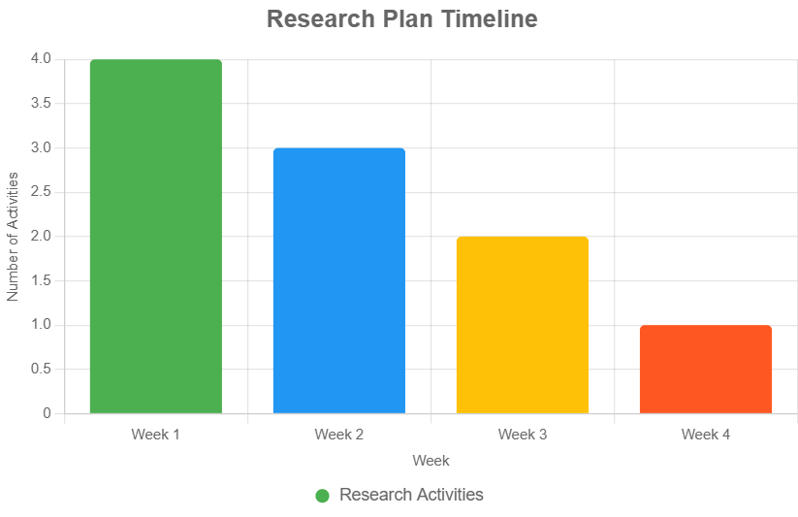
Research Plan
f. Research Schedule
Week 1: Data analysis, survey design.
Week 2: Survey distribution, collection.
Week 3: Usability testing sessions.
Week 4: Analysis, recommendations.

Slide 19
Research Plan
g. Research Questions
Why do users abandon after receiving notifications?
What barriers prevent email confirmation completion?
How can notifications and the interface be optimized?
h. Research Goals
Identify pain points in the notification and email confirmation process.
Develop recommendations to streamline the user journey.
i. Participants
IdeaBox Users (10): Users who dropped off at Part 4 or 5.
Non-Users (5): Registered users who never submitted ideas.
Explanation: Participants target young adults (18–34, 76% of users) to ensure relevant insights.

Slide 20
Screening Questions
Strategy
Screening questions select participants for UT, targeting IdeaBox users and non-users, focusing on demographics, behavior, and interview willingness.
Explanation
Questions target the 18–34 demographic, assess drop-off stages (especially Part 4–5), and confirm UT participation. The open-ended question provides insights into barriers like notification clarity.

Slide 21
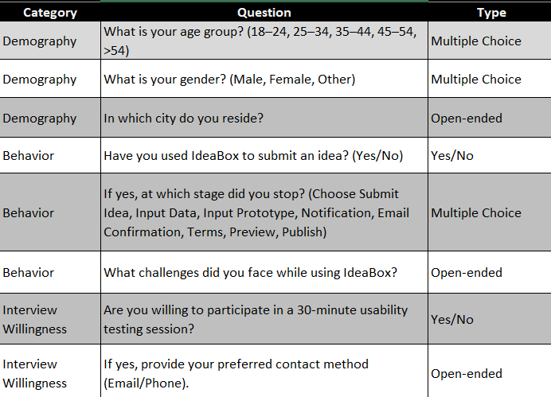
Screening Questions

Slide 22
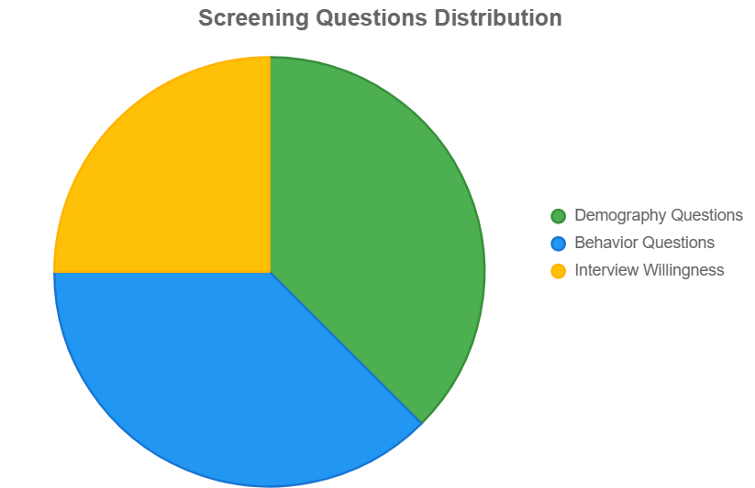
Screening Questions

Slide 23
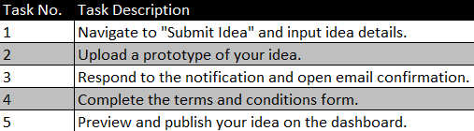
Task UT
Strategy
UT tasks simulate the submission process, focusing on the 56% drop-off between Part 4 and Part 5. The SEQ scale (1–7) is visualized as a doughnut diagram with hypothetical data to reflect anticipated usability outcomes.
Results and Explanation
Scenario:
You are an innovator seeking to submit a business idea on IdeaBox to attract investors and realize your idea.

Slide 24
Task UT
Post-UT Questions:
Describe what you did to complete each task.
What did you like about the process?
What did you find difficult or frustrating?
Rate the ease of completing the tasks on a scale of 1–7 (SEQ: 1 = Very Difficult, 7 = Very Easy).
What improvements would make the process a 7?
Explanation
Tasks focus on Part 4–5 to investigate the drop-off. The SEQ diagram uses hypothetical data based on anticipated UT outcomes, reflecting challenges at Part 4–5 (lower scores) and easier tasks like Part 1 and 5 (higher scores).

Slide 25
Task UT
SEQ Scale Diagram:
Data Source: Hypothetical SEQ scores from 15 participants (10 IdeaBox users, 5 non-users), assuming challenges with notification/email confirmation (Task 3) result in lower scores, while navigation and publishing are rated higher.
Scores (average counts): 1 (1 user), 2 (2 users), 3 (4 users), 4 (3 users), 5 (3 users), 6 (1 user), 7 (1 user).
Explanation: The distribution peaks at 3–4, indicating moderate difficulty, particularly for Task 3, aligning with the 56% drop-off. Higher scores (6–7) reflect easier tasks like navigation and publishing.

Slide 26
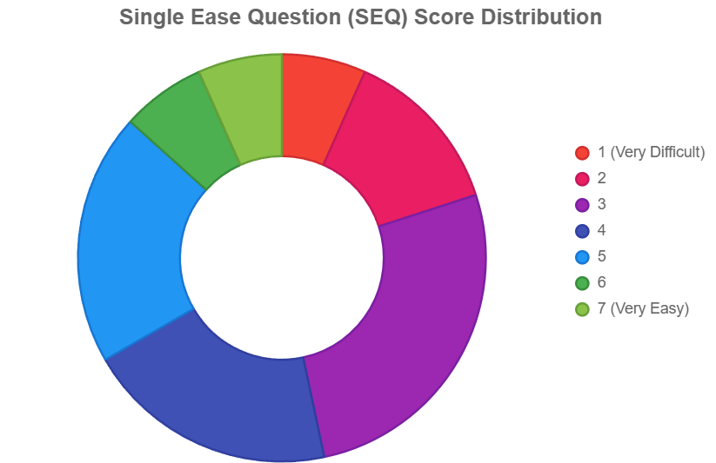
Task UT

Slide 27
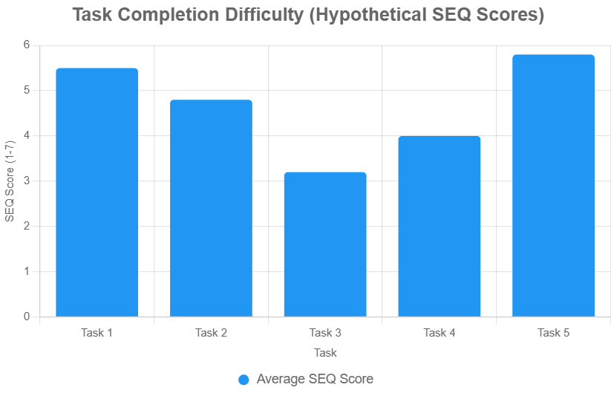
Task UT
Task Completion Difficulty
Explanation: This diagram ranks UT tasks by anticipated SEQ scores (hypothetical averages), highlighting Task 3 (notification/email) as the most difficult, aligning with the funnel drop-off.

Slide 28
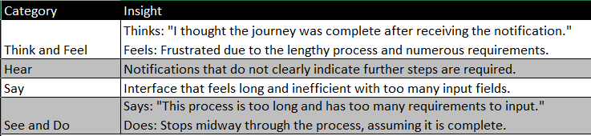
5. Insights & Recommendations
Strategy
Using an empathy map, I mapped anticipated insights from survey and UT data to understand user pain points and propose recommendations to address the drop-off.
Results and Explanation

Slide 29
5. Insights & Recommendations
Recommendations:
Simplify the Process: Reduce required input fields in the terms and conditions stage or provide detailed guidance on acceptable file formats (e.g., PDF, JPG).
Clear Notifications: Include explicit instructions, e.g., "Check your email to continue your submission."
Enhanced Email Communication: Add a prominent call-to-action button in confirmation emails.
Progress Indicators: Implement a progress bar to show the user’s position in the journey.
Onboarding Guide: Introduce a short video or tooltips to explain the submission process.
Explanation
Insights confirm user confusion and frustration, aligning with the 56% drop-off at Part 5 and the SEQ diagram’s lower scores for Task 3. Recommendations address these by simplifying inputs, enhancing clarity, and guiding users.

Slide 30
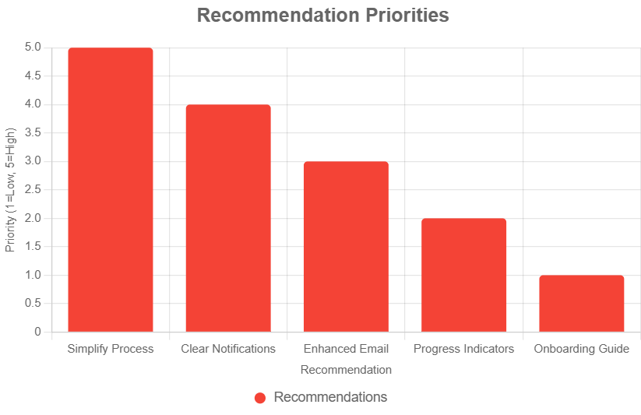
5. Insights & Recommendations

Slide 31
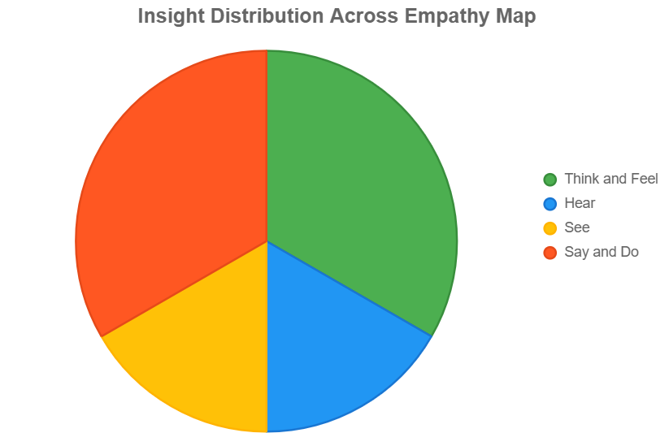
5. Insights & Recommendations
Insight Distribution
Explanation: This diagram visualizes the distribution of insights across empathy map categories, emphasizing “Think and Feel” and “Say and Do” as dominant pain points.

Slide 32
Thank You
X
Logo Company

